Slide 1
Data Mind – {Logo+Punchline TM}

Slide 2
Class 2: Table of Contents
Python Data Structures/Types
Int
Float
Str
List
Tuple
Range
Set
Frozenset
Dictionary
Boolean
DataFrame (pandas)/Series
Overview of key packages:
Numpy
Pandas
Matplotlib
Seaborn
Scikit-learn

Slide 3
Class 2: Numeric types
Numeric Types
int :
Integer objects such as 1, 2,1000, 9999
a = 1
If you print type(a) → type of a is <class 'int'>
float:
example: 3.1, 4.2, 9999.00
a = 1.0
If you print type(a) → type of a is <class ‘float'>
complex :
3+4(i) – We will not worry too much about complex in our course

Slide 4
Class 2: Strings
Strings: Collection of alphabets or sentences.
String literals have to use single (‘) or double quotes (“) in python.
Multi-line string literals should use triple quotes
Eg of strings: “Ram is going to office” , “ Mark is the owner of Facebook”, “abcefgh”, “12345”.
String class is als associated with many methods such as __getitem__, __len__ etc.
Strings are immutable, meaning you cannot modify an existing string

Slide 5
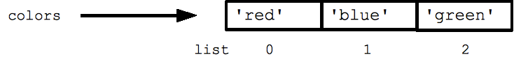
Class 2: Lists
Sequence Types — list, tuple, range
list: lists are sequences of objects. List literals are denoted by square brackets. Lists can hold any types of objects at once
Example
colors= [“red”, “blue”, ”green”]
Assignment with an = on lists does NOT make a copy. Instead, assignment makes the two variables point to the one list in memory
Source: https://developers.google.com/edu/python/lists

Slide 6
Class 2: Iteration over list
Python's *for* and *in* constructs are extremely useful, and the first use of them we'll see is with lists. The *for* construct -- for var in list -- is an easy way to look at each element in a list (or other collection).
Do not add or remove from the list during iteration.
If you know what sort of thing is in the list, use a variable name in the loop that captures that information such as "num", or "name", or "url". Since python code does not have other syntax to remind you of types, your variable names are a key way for you to keep straight what is going on.
Example:
Number_list = [1,2,3,4,5]
We should use “for number in Number_list” to make it clear that the list contains numbers
The “in” operator is an easy way to check if a particular value is present in a list and do computations based on that outcome:
Example: 4 in Number_list will output a True
This is also an example of Boolean data types
Boolean is simply a True / False type
In python comparison is done by “==“ operator while the “=“ operator is used for assignment
Source: https://developers.google.com/edu/python/lists

Slide 7
Class 2: Ranges
Range function yields a continuous sequence of numbers based on input
Range (i) will yield 0,1,2,3,4,…., i-1
Useful to iterate over data frames, lists, etc based on their lengths/shape
The combination of the for-loop and the range() function allow you to build a traditional numeric for loop
Source: https://developers.google.com/edu/python/lists

Slide 8
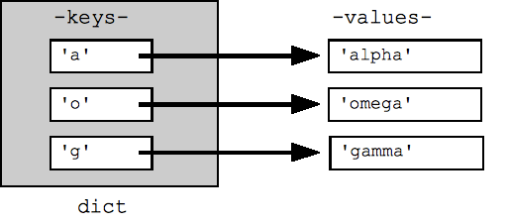
Class 2: Dictionary
Python's efficient key/value hash table structure is called a "dict". The contents of a dict can be written as a series of key:value pairs within braces { }, e.g. dict = {key1:value1, key2:value2, ... }.
The "empty dict" is just an empty pair of curly braces {}.
Looking up or setting a value in a dict uses square brackets, e.g. dict['foo'] looks up the value under the key 'foo'. Strings, numbers, and tuples work as keys, and any type can be a value. Other types may or may not work correctly as keys (strings and tuples work cleanly since they are immutable).
Looking up a value which is not in the dict throws a KeyError -- use "in" to check if the key is in the dict, or use dict.get(key) which returns the value or None if the key is not present (or get(key, not-found) allows you to specify what value to return in the not-found case).
Source: https://developers.google.com/edu/python/dict-files

Slide 9
Class 2: Tuples
Tuples are immutable sequences. Typically they are used to store record type data, or to return multiple values from a function.
Tuples behave a lot like lists and support many of the same operations with similar behavior, aside from their immutability. We'll consider them briefly here.
Tuples are represented as (a,b)

Slide 10
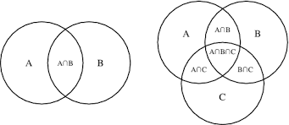
Class 2: Sets
Set: A set is a mutable unordered collection that cannot contain duplicates. Sets are used to remove duplicates and test for membership. One use for sets is to quickly see differences.
A set object is an unordered collection of immutable values. Common uses include membership testing, removing duplicates from a sequence, and computing mathematical operations such as intersection, union, difference, and symmetric difference.
For example, if you have two dicts and want to see what keys are in one but not the other
Sets are usually used to get unique values or to find intersection b/w one
Frozen set is just an immutable version of a Python set object. While, elements of a set can be modified at any time, elements of frozen set remains the same after creation. Useful to create dictionaries which will remain same throughout.
Source: http://mathworld.wolfram.com/VennDiagram.html

Slide 11
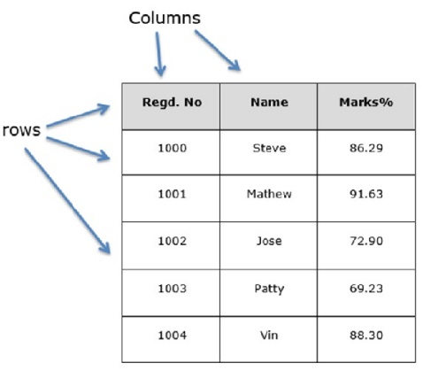

Class 2: Pandas DataFrame & Series
Pandas DataFrame: The most important object we will deal with in this course. DataFrames as simply 2 dimensional mutable arrays with rows, columns, and index
Official Definition: Two-dimensional size-mutable, potentially heterogeneous tabular data structure with labeled axes (rows and columns). Arithmetic operations align on both row and column labels. Can be thought of as a dict-like container for Series objects. The primary pandas data structure
Think of dataframe as an excel sheet with n*t table
Pandas series are simply 1d dataframes or simply an array in pandas library
Series is a one-dimensional labeled array capable of holding any data type (integers, strings, floating point numbers, Python objects, etc.)
Pandas dataframe
Pandas series
index of series

